Slide 1
Universal GenAI Agent
COMP4801 Final Year Project
FUNG Ho Sang (3035927386)
24/4/2025

Slide 2





OUTLINE
Introduction
- Background Motivation
- Aim & Objectives
Methodology
- System Architecture
- Design Choices
Final Result
(Live-Demo)
Final Progress &
Future Enhancement Ideas
Conclusion

Slide 3

INTRODUCTION
Overview
GenAI chatbot
      Connects to third-party services
Delivers personalized content
All-in-one place for all information updates and routine tasks
Importance
Minimal effort, reduce mental strain
I DELIVER UPDATES!

Slide 4

BACKGROUND MOTIVATION
We need too much information every day.
Football club news
Job postings
  Cheap flight tickets
Daily Cat pics
and so much more…

Slide 5
INFORMATION OVERLOAD
Definition
The overwhelming amount of data that negatively affects decision-making, productivity, and mental well-being [1].
Statistics
80% experience information overload
        27% needing to access more than 11 tools daily
      Nearly half of respondents spend > 1 hour daily searching for information [2]
[1] J. Spira, "Information Overload: A Systematic Review of the Literature," Information Overload Research Group, 2019. https://www.researchgate.net/publication/265906917_Information_Overload_A_Systematic_Literature_Review (accessed Oct. 14, 2024).
[2] S. Ono, “Unlock the information advantage to combat ‘information overload’,” OpenText Blogs, 2022. https://blogs.opentext.com/unlock-the-information-advantage-to-combat-information-overload/ (accessed Nov. 30, 2024).

Slide 6




OTHER PROBLEMS
  Lack of RSS feed
  Hard to notice information update
  Time & Energy to analyze information

Slide 7
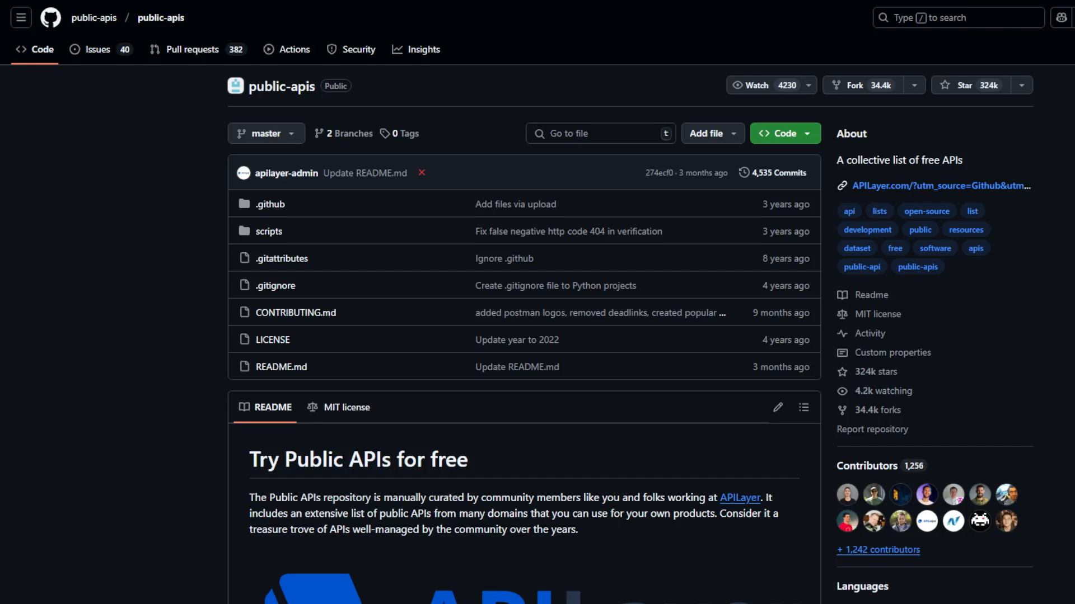
DESIGN IDEAS
There is likely an API for everything we may want.
List of public APIs: https://github.com/public-apis/public-apis

Slide 8
DESIGN IDEAS
Instead of actively looking for the information,
Why can’t we:
Passively wait for the information to be delivered
in an AI-digested manner
Interact with the information
Perform routine tasks
All in one centralized place

Slide 9



EXAMPLE USE CASES
1
2
3
FOOTBALL CLUB NEWS
Daily digests of:
Football Club’s latest feed for fans
JOB SEEKING
Updates on:
Personalized Job openings
Upcoming career fairs
TRAVEL ALERTS
Updates on:
Travel restrictions
Airline’s special offers

Slide 10


AIM
Help users save time & energy in
Obtaining personalized information
Performing routine tasks

Slide 11
OBJECTIVES
To Develop an All-Purpose GenAI-Embedded Agent that can:
  Integrate seamlessly with a wide range of third-party services
  Deliver tailored content to users regularly (e.g. daily)
  Allow effortless user interaction
To explore new use cases of GenAI in a content delivery system
I CAN DO EVERYTHING!

Slide 12



USER-FACING WORKFLOW
1
2
Input additional info
Select preferences
Football
Job postings
Cats
Fashion
Location:
Job Type:
Experience Level:
3
Created user profile
Interval to receive content
Hourly
Daily
Weekly
ALL SET!

Slide 13




METHODOLOGY
User profile will be updated after every user request to make the content tailoring most relevant.
2
Retrieve User’s
Stored Preferences
________________________________________________________________________________________________________________________
I LOVE CATS!!!
________________________________________
Digest & Personalized by GenAI
(Prompt Engineering)
Scrape content from
Website / API
Deliver to user
1
3
4

Slide 14

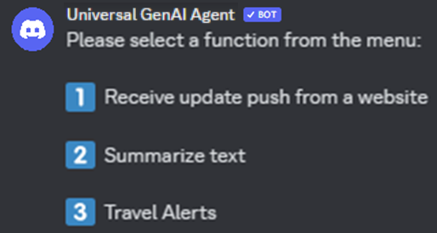


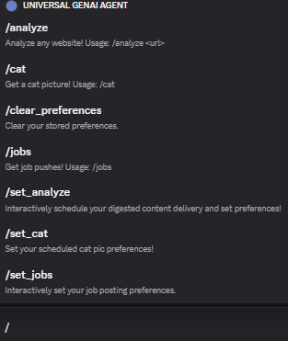


SYSTEM ARCHITECTURE
Instant messaging platform
Web scraping / API
/
Master server
Retrieve raw data from source
Database
Personalized content
Handles all events
Retreieve user preferences
Cron job
GenAI Service
Regularly perform the workflow (to push notifications to users)
Analyze & Process content for the user

Slide 15
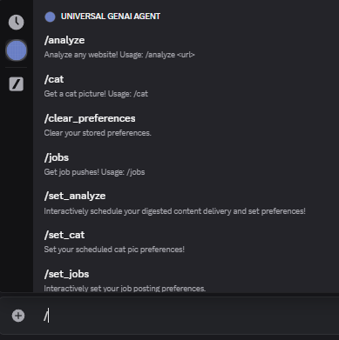
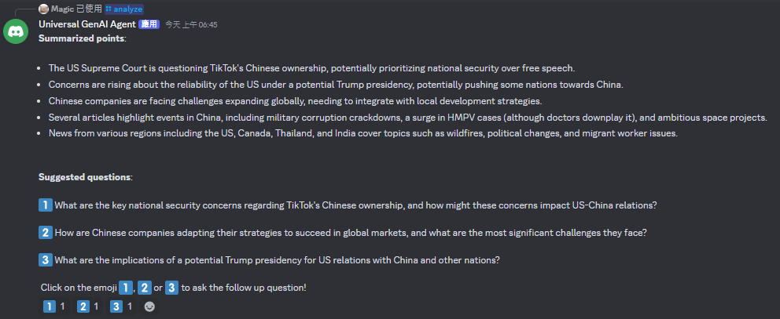
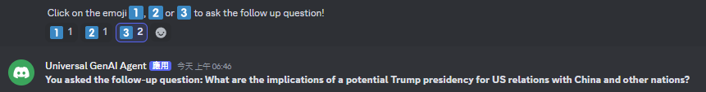
DESIGN CHOICES – Interaction UI
Discord
Popular daily communication app
Receive notification as message
Allow easy interaction
“Slash commands”
Add Reactions

Slide 16

DESIGN CHOICES – Database
NeDB
Lightweight Schema-less database
userId {
}
analyze: { site: “scmp.com”,
frequency: “every hour”}
job: { keyword: “software engineer”,
frequency: “daily”}
… More preferences for other specialized purposes can be stored
Flexibility in data structure during future expansion

Slide 17
DESIGN CHOICES – Web Scraping
Selenium
Simulate real-browser behaviour
Dynamic websites
e.g. React.js, Vue.js

Slide 18

DESIGN CHOICES – Programming
Node.js
Asynchronous, event-driven architecture
        Efficiently handles multiple concurrent tasks
High compatibility with third-party API
100% Node.js

Slide 19

ETHICAL CONSIDERATION
Web Scraping
Comply with website’s Terms of Service
Publicly accessible content only
Data Storage
Personally Identifiable Information
The user can request to remove all data collected about him/her.

Slide 20

FINAL RESULTS - LIVE DEMO
Analyze web page (e.g. news content)

Slide 21
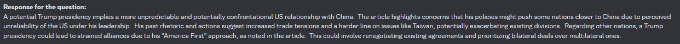
FINAL RESULTS - LIVE DEMO
Ask follow-up questions

Slide 22
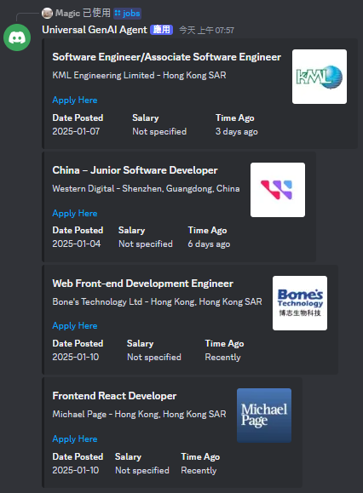

FINAL RESULTS - LIVE DEMO
Fetch Job Posting

Slide 23
FINAL PROGRESS SUMMARY
Completed
(Aug – Dec ‘24)
Connection to GenAI Service
Connection to Discord API
Web Scraping and GenAI Summarization Workflow
Fetch Job postings from Linkedin API
Fully Completed
In progress
(Jan – Apr ‘25)
Database Setup
UI to Set User Preferences
Cron Job Setup
Integrate more services
Preliminary Release
Testing and Fine-tuning
(e.g. of Personal interest tracking – Cat Pictures API)

Slide 24
POTENTIAL FUTURE ENHANCEMENTS
New Commands:
  /sports: Provide live updates or scores for ongoing games in selected sports (e.g. football, basketball).
  /flights: Check for cheap flight deals and travel alerts.
  /events: Upcoming local events or concerts based on user interests.
Community Features:
Enable users to create groups or channels for shared interests and discussions.

Slide 25
CONCLUSION
Enhanced information delivery
  Smart Notification system + Content delivery system + AI Chatbot
Reduce Information Overload:
  Minimize search time and mental effort
Effortless User Interaction:
  interface for easy engagement
  Make LLM more interactive with real-life practical uses
Highly Customizable:
  Personalized to address diverse user needs across jobs / personal interests
Aim to benefit everyone as we all have interests to track.

Slide 26
REFERENCES
[1] J. Spira, "Information Overload: A Systematic Review of the Literature," Information
Overload Research Group, 2019.
https://www.researchgate.net/publication/265906917_Information_Overload_A_Systematic_Literature_Review (accessed Oct. 14, 2024).
[2] S. Ono, “Unlock the information advantage to combat ‘information overload’,”
OpenText Blogs, 2022. https://blogs.opentext.com/unlock-the-information-advantage-to-combat-information-overload/ (accessed Nov. 30, 2024).

Slide 27
Q&A SESSION
THANK YOU!
By FUNG Ho Sang (3035927386)

